Slide 1
Learning Objective
I will be able to determine types of stationary points
Success Criteria
At the end of the lesson, I will be able to:
Determine the types of stationary points

Slide 2
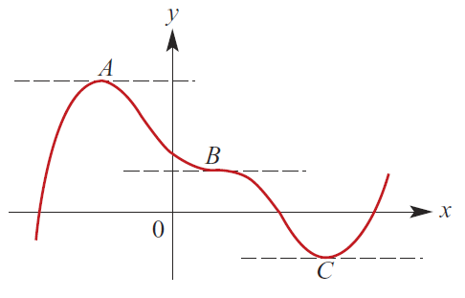
Stationary Point
Concept Development
If at point$x=a{, f}^{′}\left(a\right)=0$, $x=a$ is said to be a stationary point.
There are stationary points at A, B and C.
At such points, the gradient of the tangents are 0.
The stationary point at point A is called
Local maximum point
Gradient
Shape of f
+
0
-

Slide 3
Stationary Point
Concept Development
If at point$x=a{, f}^{′}\left(a\right)=0$, $x=a$ is said to be a stationary point.
There are stationary points at A, B and C.
At such points, the gradient of the tangents are 0.
The stationary point at point C is called
Local minimum point
Gradient
Shape of f
-
0
+

Slide 4
Stationary Point
Concept Development
If at point$x=a{, f}^{′}\left(a\right)=0$, $x=a$ is said to be a stationary point.
There are stationary points at A, B and C.
At such points, the gradient of the tangents are 0.
The stationary point at point B is called
Stationary point of inflection
Gradient
Shape of f
-
0
-
Gradient
Shape of f
+
0
+

Slide 5
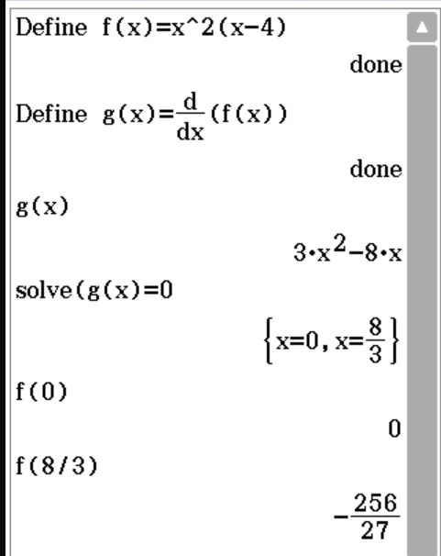

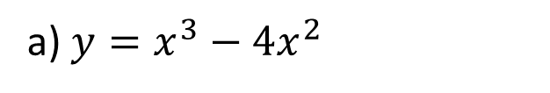

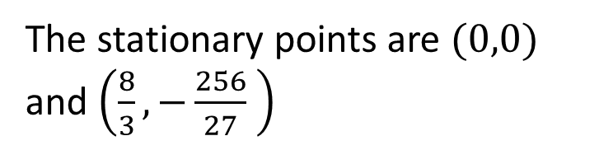


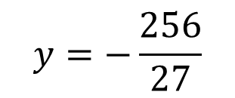

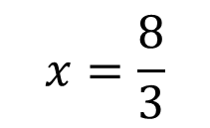
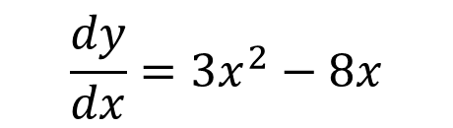
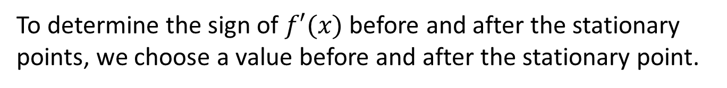

Guided Practice
a) $y=x^{3}−4x^{2}$
To determine the sign of $f′(x)$ before and after the stationary points, we choose a value before and after the stationary point.
$$\frac{dy}{dx}=3x^{2}−8x$$
$$3x^{2}−8x=0$$
$$x(3x−8)=0$$
$$x=\frac{8}{3}$$
$$x=0$$
$$y=−\frac{256}{27}$$
$$y=0$$
$f′\left(−1\right)=3+8=11>0$
$f′\left(1\right)=3−8=−5<0$
The stationary points are $(0,0)$ and $\left(\frac{8}{3},−\frac{256}{27} \right)$
(0, 0) is a local maximum point

Slide 6

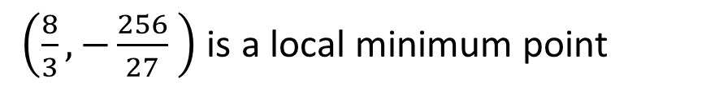

Guided Practice
a) $y=x^{3}−4x^{2}$
To determine the sign of $f′(x)$ before and after the stationary points, we choose a value before and after the stationary point.
$$\frac{dy}{dx}=3x^{2}−8x$$
$$3x^{2}−8x=0$$
$$x(3x−8)=0$$
$$x=\frac{8}{3}$$
$$x=0$$
$$y=−\frac{256}{27}$$
$$y=0$$
$f′\left(1\right)=3−8=−5<0$
The stationary points are $(0,0)$ and $\left(\frac{8}{3},−\frac{256}{27} \right)$
$f′\left(3\right)=27−24=3>0$
$\left(\frac{8}{3},−\frac{256}{27} \right)$ is a local minimum point

Slide 7


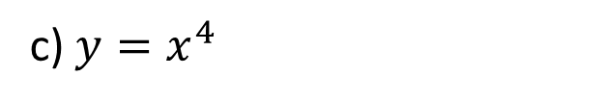




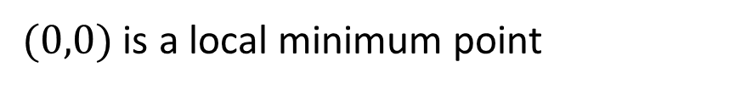

Guided Practice
c) $y=x^{4}$
To determine the sign of $f′(x)$ before and after the stationary points, we choose a value before and after the stationary point.
$$\frac{dy}{dx}=4x^{3}$$
$$4x^{3}=0$$
$$x=0$$
$$y=0$$
The stationary point i$s (0,0)$
$$f^{′}(−1)=−4<0$$
$f′\left(1\right)=4=1>0$
$(0,0)$ is a local minimum point

Slide 8
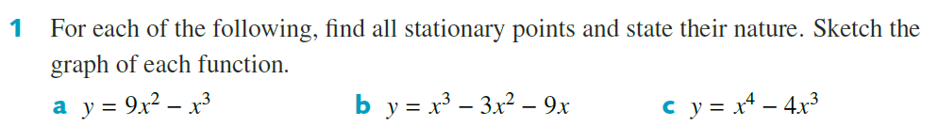

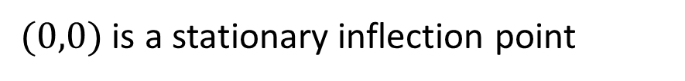
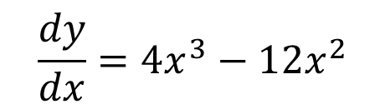
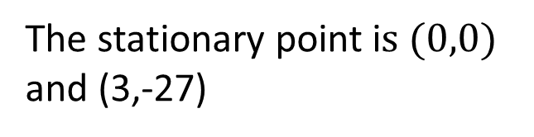







Guided Practice
To determine the sign of $f′(x)$ before and after the stationary points, we choose a value before and after the stationary point.
$$\frac{dy}{dx}=4x^{3}−12x^{2}$$
$$4x^{3}−12x^{2}=0$$
$$4x^{2}(x−3)=0$$
$$x=0$$
$$x=3$$
$$y=0$$
$$y=−27$$
The stationary point i$s (0,0)$ and (3,-27)
$$f^{′}(−1)=−16<0$$
$f^{′}(1)=−8<0$
$(0,0)$ is a stationary inflection point

Slide 9

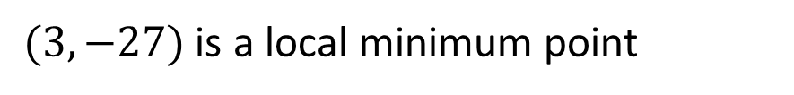

Guided Practice
To determine the sign of $f′(x)$ before and after the stationary points, we choose a value before and after the stationary point.
$$\frac{dy}{dx}=4x^{3}−12x^{2}$$
$$4x^{3}−12x^{2}=0$$
$$4x^{2}(x−3)=0$$
$$x=0$$
$$x=3$$
$$y=0$$
$$y=−27$$
The stationary point i$s (0,0)$ and (3,-27)
$$f^{′}(1)=−8<0$$
$f^{′}\left(4\right)=64>0$
$(3,−27)$ is a local minimum point

Slide 10
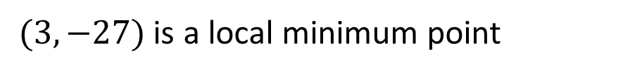
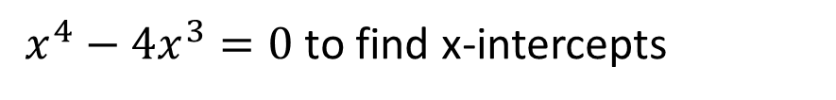

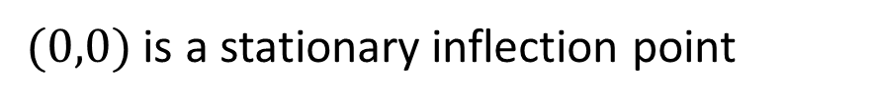
Guided Practice
The stationary points are$(0,0)$ and (3,-27)
$(0,0)$ is a stationary inflection point
$(3,−27)$ is a local minimum point
$x^{4}−4x^{3}=0$ to find x-intercepts
$x^{3}(x−4)=0$
x=0 x= 4

Slide 11
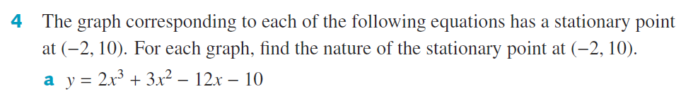
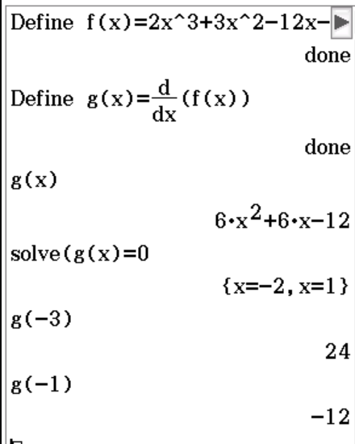

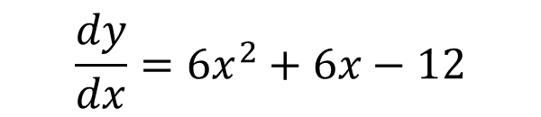


Guided Practice
$$\frac{dy}{dx}=6x^{2}+6x−12$$
$$f^{′}\left(−3\right)=24>0$$
$$f^{′}\left(−1\right)=−12<0$$
$∴(−2,10)$ is a local maximum point

Slide 12
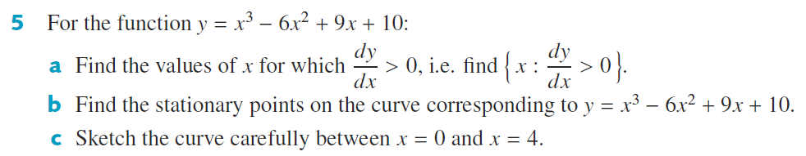
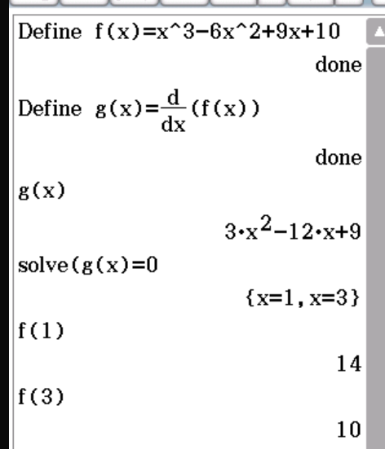
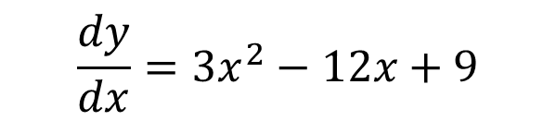
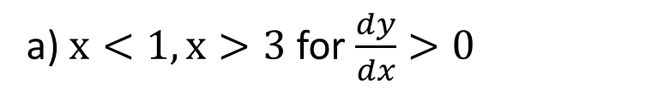
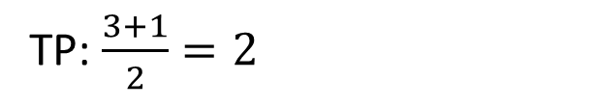
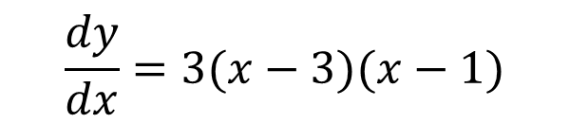
Guided Practice
$$\frac{dy}{dx}=3x^{2}−12x+9$$
$$\frac{dy}{dx}=3(x−3)(x−1)$$
TP: $\frac{3+1}{2}=2$
a) $x<1, x>3$ for $\frac{dy}{dx}>0$
Stationary points are x=1, 3
b) Coordinates of stationary points are (1, 14), (3, 10)

Slide 13



Guided Practice
$$\frac{dy}{dx}=3x^{2}−12x+9$$
Coordinates of stationary points are (1, 14), (3, 10)
$$f^{′}\left(0\right)=9>0$$
(1, 14) is a local maximum point
$$f^{′}\left(2\right)=−3<0$$
(3, 10) is a local minimum point
$$f^{′}\left(4\right)=9>0$$

Slide 14

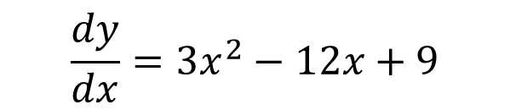







Guided Practice
$$\frac{dy}{dx}=3x^{2}−12x+9$$
Coordinates of stationary points are (1, 0), (3, -4)
$$f^{′}\left(0\right)=9>0$$
(1, 0) is a local maximum point
$$f^{′}\left(2\right)=−3<0$$
(3, -4) is a local minimum point
$$f^{′}\left(4\right)=9>0$$
$x=0, y=−4$
$y=0, x^{3}−6x^{2}+9x−4=0$
$$x−1 is a factor, use division to find the remaining factors$$
$$\left(x−1\right)\left(x^{2}−5x+4\right)=0$$
$$\left(x−1\right)\left(x−4)(x−1\right)=0$$
$${\left(x−1\right)}^{2}(x−4)=0$$
Intercepts are: $\left(0,−4\right), (1,0)(4,0)$

Slide 15
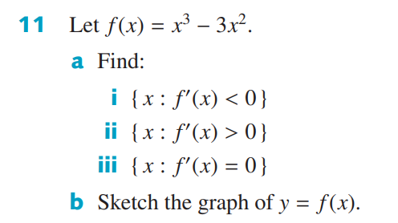

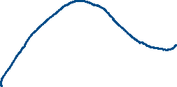







Guided Practice
$$\left\{x:0<x<2\right\}=\left(0,2\right)$$
$$\left\{x:x<0\right\}∪\left\{x:x>2\right\}=\left(−∞,0\right)∪\left(2,∞\right)$$
$$\{0,2\}$$
$$f^{′}\left(x\right)=3x^{2}−6x$$
$$=3x(x−2)$$
For $f^{′}\left(x\right)=0, 3x\left(x−2\right)=0$
$$x=0, x=2$$
$$f^{′}\left(−1\right)=3\left(−1\right)\left(−3\right)=9>0$$
$$f^{′}\left(1\right)=3\left(1\right)\left(−1\right)=−3<0$$
$$f^{′}\left(3\right)=3\left(3\right)\left(1\right)=9>0$$

Slide 16
Independent Practice
Complete Cambridge Ex 18D

